Slide 1
RISK MANAGEMENT Module 2
Chapter 28
Page no. 744 -
7th EDITION
Roger S. Pressman,

Slide 2
What is Risk?
Risk concerns future happenings. By changing our actions today, create an opportunity for a different and hopefully better situation for ourselves tomorrow
What is it? Risk analysis and management are actions that help a software team to understand and manage uncertainty
Who does it? Everyone involved in the software process—managers, software engineers, and other stakeholders—participate in risk analysis and management.
What are the steps?
1) Recognizing what can go wrong, called “risk identification.”
2) determine the likelihood that it will occur and the damage that it will do if it does occur.
3) Once this information is established, risks are ranked
4) a plan is developed to manage those risks that have high probability and high impact

Slide 3
Solution for the risk management
What is the work product? A risk mitigation, monitoring, and management (RMMM) plan or a set of risk information sheets is produced.
Reactive risk strategies
proactive strategy – (Planning in advance) A considerably more intelligent strategy for risk management is to be proactive. A proactive strategy begins long before technical work is initiated.
Potential risks are identified, their probability and impact are assessed, and they are ranked by importance.
Then, the software team establishes a plan for managing risk.
The primary objective is to avoid risk, but because not all risks can be avoided, the team works to develop a contingency plan that will enable it to respond in a controlled and effective manner.

Slide 4
Contd…
Risk always involves two characteristics:
uncertainty—the risk may or may not happen; that is, there are no 100 percent guarantee
and loss—if the risk becomes a reality, unwanted consequences or losses will occur.
When risks are analyzed, it is important to quantify the level of uncertainty and the degree of loss associated with each risk. To accomplish this, different categories of risks are considered.
Project risks: Project risks identify potential budgetary, schedule, personnel (staffing and organization), resource, stakeholder, and requirements problems and their impact on a software project.
Technical risks identify potential design, implementation, interface, verification, and maintenance problems
Business risks threaten the viability of the software to be built

Slide 5
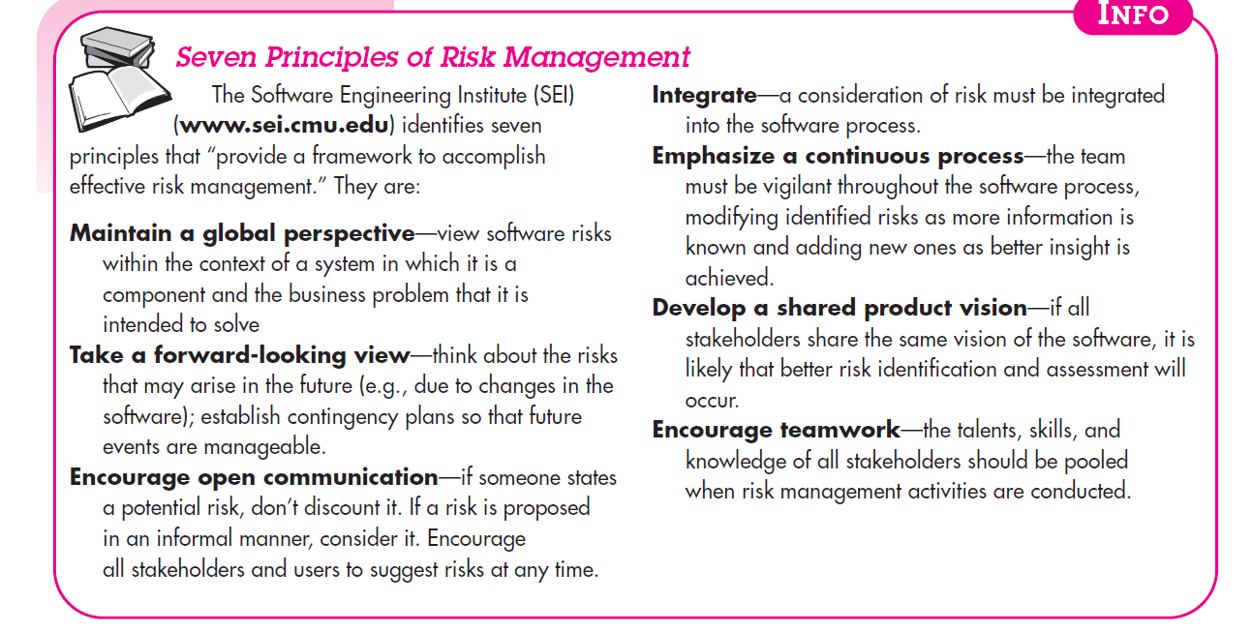
Seven Principles of Risk Management

Slide 6
Risk identification
systematic attempt to specify threats to the project plan (estimates, schedule, resource loading, etc.).
By identifying known and predictable risks,
the project manager takes a first step toward avoiding them when possible and controlling them when necessary.
There are two distinct types of risks:
Generic risks are a potential threat to every software project.
Product-specific risks can be identified only by those with a clear understanding of the technology

Slide 7
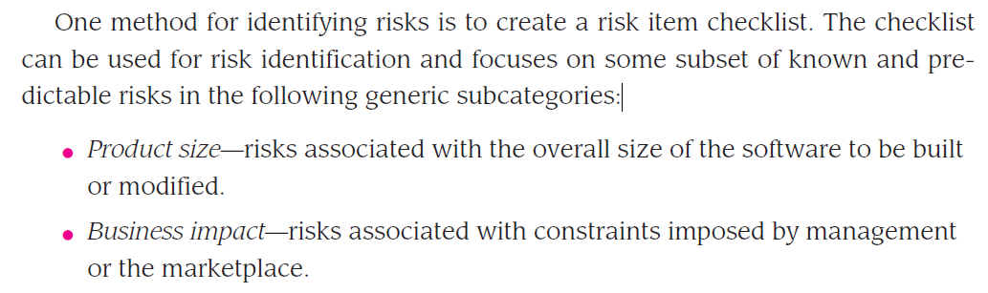
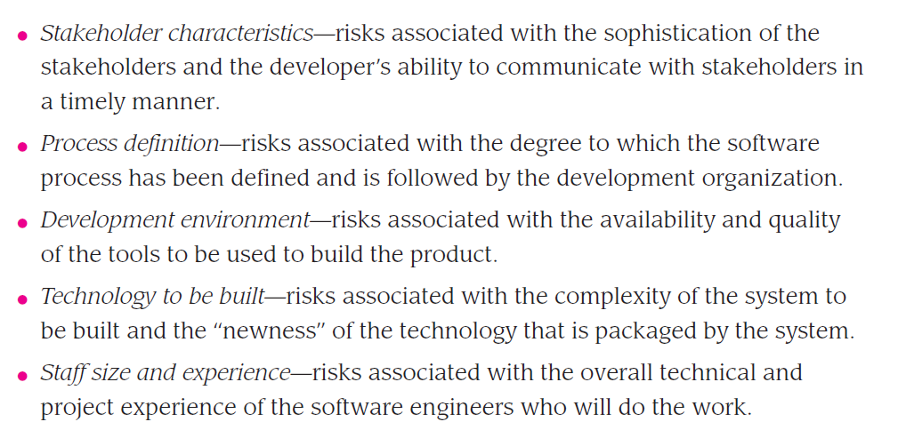
Contd…

Slide 8
Risk projection
Risk projection, also called risk estimation, attempts to rate each risk in two ways— (1) the likelihood or probability that the risk is real and (2) the consequences of the problems associated with the risk

Slide 9
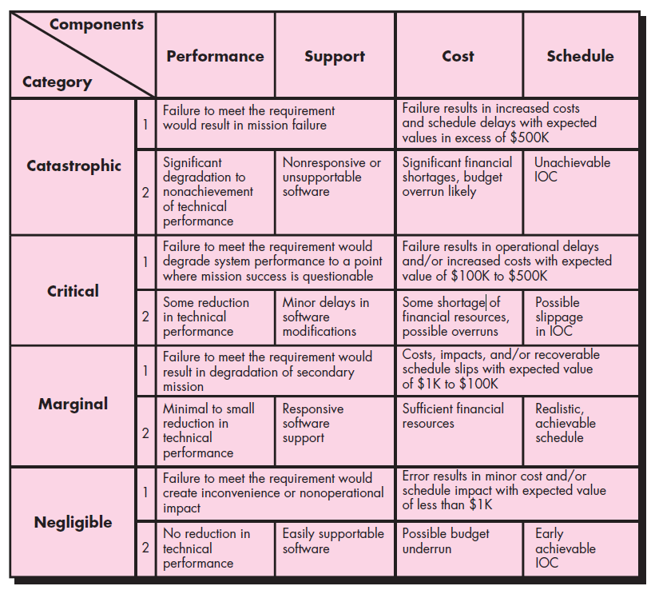
Impact assessment.

Slide 10
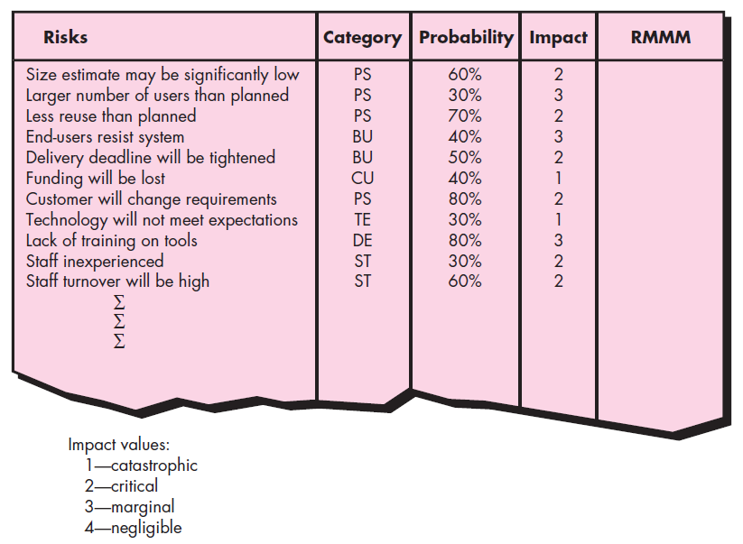
Sample risk table prior to sorting

Slide 11
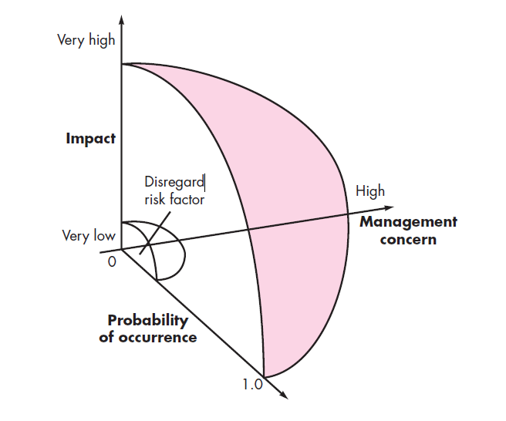
Contd…

Slide 12
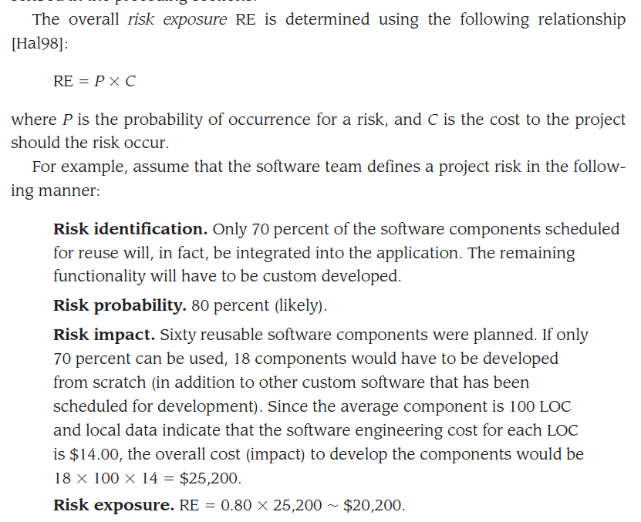
Assessing Risk Impact**

Slide 13
RISK MITIGATION, MONITORING, AND MANAGEMENT
All of the risk analysis activities presented to this point have a single goal—to assist the project team in developing a strategy for dealing with risk.
An effective strategy must consider three issues: risk avoidance, risk monitoring, and risk management and contingency planning.

Slide 14
THE RMMM PLAN
The RMMM plan documents all work performed as part of risk analysis and is used by the project manager as part of the overall project plan.
Some software teams do not develop a formal RMMM document. Rather, each risk is documented individually using a risk information sheet (RIS)

Slide 15
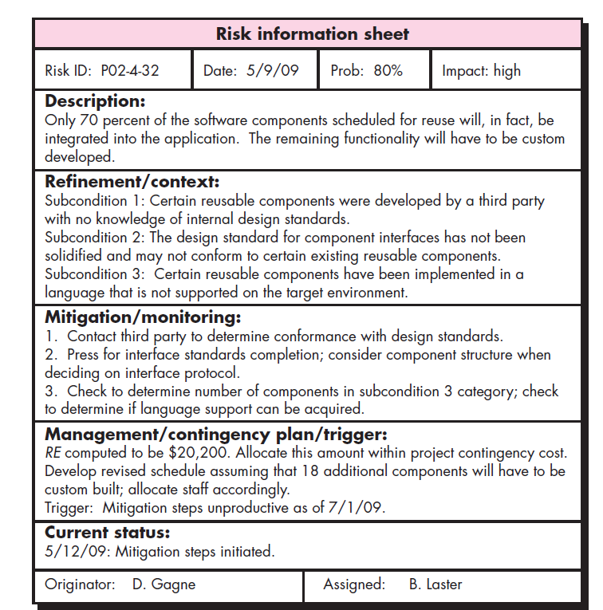
Example of RMMM Plan

